Slide 1
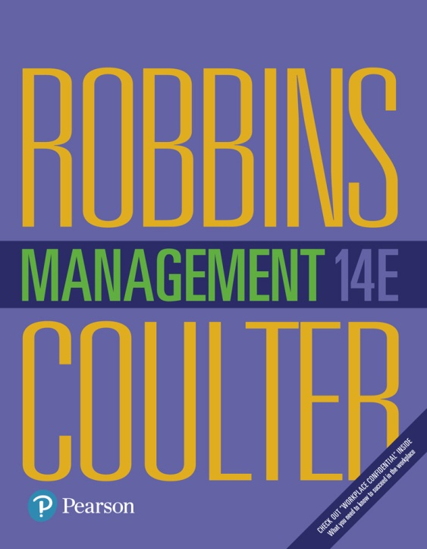
Management
Fourteenth Edition
Chapter 9
Making Decisions
Copyright © 2018, 2016, 2014 Pearson Education, Inc. All Rights Reserved

Slide 2
Learning Objectives
9.1 Define strategic management and explain why it’s important.
9.2 Explain what managers do during the six steps of the strategic management process.
Know how to identify your own personal strengths and weaknesses and deal with them.
Develop your skill at strategic planning.
9.3 Describe the three types of corporate strategies.
9.4 Describe competitive advantage and the competitive strategies organizations use to get it.
9.5 Discuss current strategic management issues.

Slide 3
What is Strategic Management?
Strategic management: what managers do to develop the organization’s strategies.
An important task involving all basic management functions- Planning, organizing, leading and controlling.
Notes:
Strategic management is what managers do to develop the organization’s strategies. It’s an important task involving all the basic management functions—planning, organizing, leading, and controlling. What are an organization’s strategies? They’re the plans for how the organization will do whatever it’s in business to do, how it will compete successfully, and how it will attract and satisfy its customers in order to achieve its goals.
One term often used in strategic management is business model, which simply is how a company is going to make money. It focuses on two things: (1) whether customers will value what the company is providing and (2) whether the company can make any money doing that.

Slide 4
Strategies: the plans for how the organization will do what it’s in business to do, how it will compete successfully, and how it will attract and satisfy its customers in order to achieve its goals
Business model: how a company is going to make money. Focus on two things :
i. customer will value what company is providing
Ii. Whether company can make any money doing that e.g. Jeff bezos, business model, selling books online turned into selling everything online.

Slide 5
Why is Strategic Management Important?
Has a positive impact on performance
Helps managers decide how to act in face of change and uncertainty
Helps complex and diverse organizations work together e.g. i. 2.2 million employees work in Walmart stores.
USPS- locked in battle for overnight delivery
Notes:
Why is strategic management so important? There are three reasons. The most significant one is that it can make a difference in how well an organization performs. In other words, it appears that organizations that use strategic management do have higher levels of performance. And that fact makes it pretty important for managers.
Another reason it’s important has to do with the fact that managers in organizations of all types and sizes face continually changing situations. They cope with this uncertainty by using the strategic management process to examine relevant factors and decide what actions to take.
Finally, strategic management is important because organizations are complex and diverse. Each part needs to work together toward achieving the organization’s goals; strategic management helps do this.

Slide 6
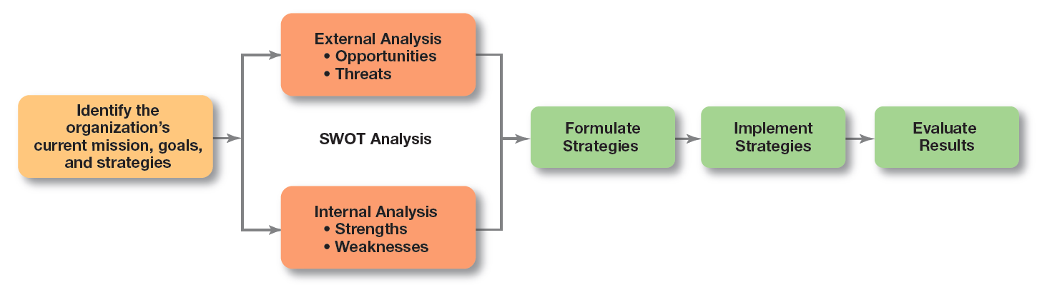
Exhibit 9-1 Strategic Management Process
Exhibit 9-1 illustrates the six-step process of strategic management, which encompasses strategy planning, implementation, and evaluation.
Notes:
Although the first four steps describe the planning that must take place, implementation and evaluation are just as important! Even the best strategies can fail if management doesn’t implement or evaluate them properly

Slide 7
Step 1: Identifying the Organization’s Current Mission, Goals, and Strategies
Mission: the purpose of an organization
Notes:
Every organization needs a mission—a statement of its purpose. Defining the mission forces managers to identify what it’s in business to do. But sometimes that mission statement can be too limiting.

Slide 8
Exhibit 9-2 Components of a Mission Statement
Component | Question
Customers | Who are the firm’s customers?
Market | Where does the firm compete geographically?
Concern for Survival, Growth, and Profitability | Is the firm committed to growth and financial stability?
Philosophy | What are the firm’s basic beliefs, values, and ethical priorities?
Concern for Public Image | How responsive is the firm to societal and environmental concerns?
Products or Services | What are the firm’s major products or services?
Technology | Is the firm technologically current?
Self-Concept | What are the firm’s major competitive advantage and core competencies?
Concern for Employees | Are employees a valuable asset of the firm?
Notes:
What should a mission statement include? Exhibit 9-2 describes some typical components.
Source: Based on R. R. Davic, Strategic Management, 13th ed. (Upper Saddle River, NJ: Pearson Education, Inc., 2011.)

Slide 9
Step 2: Doing an External Analysis
Opportunities: positive trends in the external environment
Threats: negative trends in the external environment
Notes:
Analyzing that environment is a critical step in the strategic management process. Managers do an external analysis so they know, for instance, what the competition is doing, what pending legislation might affect the organization, or what the labor supply is like in locations where it operates. In an external analysis, managers should examine the economic, demographic, political/legal, sociocultural, technological, and global components to see the trends and changes.
Once they’ve analyzed the environment, managers need to pinpoint opportunities that the organization can exploit and threats that it must counteract or buffer against. Opportunities are positive trends in the external environment; threats are negative trends.

Slide 10
Step 3: Doing an Internal Analysis
Resources: an organization’s assets that are used to develop, manufacture, and deliver products to its customers- financial, human and intangible
Capabilities: an organization’s skills and abilities in doing the work activities needed in its business
Core competencies: the organization’s major value- creating capabilities that determine its competitive weapons
Notes:
Now we move to the internal analysis, which provides important information about an organization’s specific resources and capabilities. An organization’s resources are its assets—financial, physical, human, and intangible—that it uses to develop, manufacture, and deliver products to its customers. They’re “what” the organization has. On the other hand, its capabilities are its skills and abilities in doing the work activities needed in its business—“how” it does its work. The major value-creating capabilities of the organization are known as its core competencies. Both resources and core competencies determine the organization’s competitive weapons.

Slide 11
SWOT Analysis
Strengths: any activities the organization does well or its unique resources
Weaknesses: activities the organization does not do well or resources it needs but does not possess
SWOT analysis: an analysis of the organization’s strengths, weaknesses, opportunities, and threats
Notes:
After completing an internal analysis, managers should be able to identify organizational strengths and weaknesses. Any activities the organization does well or any unique resources that it has are called strengths. Weaknesses are activities the organization doesn’t do well or resources it needs but doesn’t possess.
The combined external and internal analyses are called the SWOT analysis, an analysis of the organization’s strengths, weaknesses, opportunities, and threats. After completing the SWOT analysis, managers are ready to formulate appropriate strategies—that is, strategies that (1) exploit an organization’s strengths and external opportunities, (2) buffer or protect the organization from external threats, or (3) correct critical weaknesses.

Slide 12
Step 4: Formulating Strategies
Three main types of strategies managers will formulate:
Corporate
Competitive
Functional
Notes:
As managers formulate strategies, they should consider the realities of the external environment and their available resources and capabilities in order to design strategies that will help an organization achieve its goals. The three main types of strategies managers will formulate include corporate, competitive, and functional. We’ll describe each shortly.

Slide 13
Step 5: Implementing Strategies
No matter how effectively an organization has planned its strategies, performance will suffer if the strategies aren’t implemented properly.
Notes:
Once strategies are formulated, they must be implemented. No matter how effectively an organization has planned its strategies, performance will suffer if the strategies aren’t implemented properly.

Slide 14
Step 6: Evaluating Results
How effective have strategies been at helping the organization achieve its goals
feedback
What adjustments are necessary?
Notes:
The final step in the strategic management process is evaluating results. How effective have the strategies been at helping the organization reach its goals? What adjustments are necessary?

Slide 15
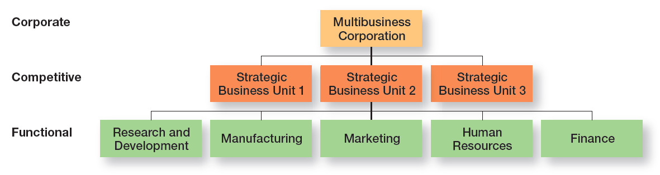
Exhibit 9-3 Types of Organizational Strategies
Exhibit 9-3 shows the three types of strategies organizations use: corporate, competitive, and functional.
Notes:
As we said earlier, organizations use three types of strategies: corporate, competitive, and functional (see Exhibit 9-3). Top-level managers typically are responsible for corporate strategies, middle-level managers for competitive strategies, and lower-level managers for the functional strategies. In this section, we’ll look at corporate strategies.

Slide 16
What is Corporate Strategy?
Corporate strategy: an organizational strategy that determines what businesses a company is in or wants to be in, and what it wants to do with those businesses. Mission of pepsico is- to be the world’s permier consumer products company focused on convenient foods and beverages.
Types – growth
Stability and
Renewal
Notes:
A corporate strategy is one that determines what businesses a company is in or wants to be in and what it wants to do with those businesses. It’s based on the mission and goals of the organization and the roles that each business unit of the organization will play.

Slide 17
What Are the Types of Corporate Strategy?
Growth strategy: a corporate strategy that’s used when an organization wants to expand the number of markets served or products offered, either through its current business(es) or through new business(es)
Concentration- focus on primary line of business
Vertical integration- backward and forward
Horizontal integration- combining woth competitors
Diversification-related or unrelated
Notes:
Organizations grow by using concentration, vertical integration, horizontal integration, or diversification.
An organization that grows using concentration focuses on its primary line of business and increases the number of products offered or markets served in this primary business.
A company also might choose to grow by vertical integration, either backward, forward, or both. In backward vertical integration, the organization becomes its own supplier so it can control its inputs.
In horizontal integration, a company grows by combining with competitors.
Finally, an organization can grow through diversification, either related or unrelated. Related diversification happens when a company combines with other companies in different, but related, industries. Unrelated diversification is when a company combines with firms in different and unrelated industries.

Slide 18
Stability and Renewal Strategies
Stability strategy: a corporate strategy in which an organization continues to do what it is currently doing.
Renewal strategy: a corporate strategy designed to address declining performance
Retrenchment or
Turnaround strategy
Notes:
Examples of a stability strategy include continuing to serve the same clients by offering the same product or service, maintaining market share, and sustaining the organization’s current business operations. The organization doesn’t grow, but doesn’t fall behind, either.
Managers need to develop strategies, called renewal strategies, that address declining performance. The two main types of renewal strategies are retrenchment and turnaround strategies.

Slide 19
How Are Corporate Strategies Managed?
When an org corporate strategy encompasses number of businesses or portfolio using a tool, called corporate portfolio matrix.
BCG matrix: a strategy tool that guides resource allocation decisions on the basis of market share and growth rate of SBUs
Stars- invest to take advantage to develop into cash cow
Cash cows- milk as much you can, dnt invest.
Question marks- diff decision- analysis required, few sold, few nurtured into stars
Dogs- should be sold off
Notes:
When an organization’s corporate strategy encompasses a number of businesses, managers can manage this collection, or portfolio, of businesses using a tool called a corporate portfolio matrix. This matrix provides a framework for understanding diverse businesses and helps managers establish priorities for allocating resources. The first portfolio matrix—the BCG matrix—was developed by the Boston Consulting Group and introduced the idea that an organization’s various businesses could be evaluated and plotted using a 2 × 2 matrix to identify which ones offered high potential and which were a drain on organizational resources. The horizontal axis represents market share (low or high), and the vertical axis indicates anticipated market growth (low or high). A business unit is evaluated using a SWOT analysis and placed in one of the four categories listed.

Slide 20
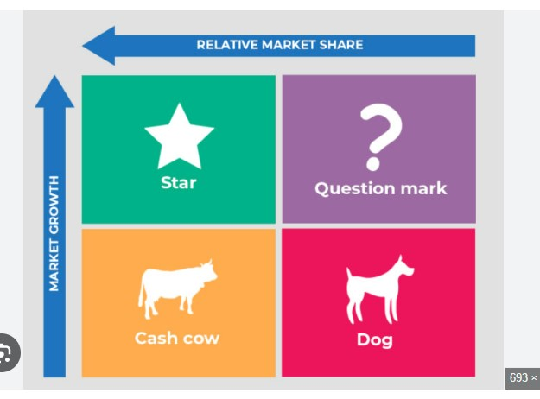

Slide 21
Competitive Strategies
Competitive strategy: an organizational strategy for how an organization will compete in its business(es)
How company will compete in its primary or main market.
When company is involved in several businesses- Strategic business unit(SBU): the single independent businesses of an organization that formulate their own competitive strategies
Notes:
For a small organization in only one line of business or a large organization that has not diversified into different products or markets, its competitive strategy describes how it will compete in its primary or main market. For organizations in multiple businesses, however, each business will have its own competitive strategy that defines its competitive advantage, the products or services it will offer, the customers it wants to reach, and the like.
When an organization is in several different businesses, those single businesses that are independent and that have their own competitive strategies are referred to as strategic business units (SBUs).

Slide 22
The Role of Competitive Advantage
Competitive advantage: What sets an organization apart; its distinctive edge
Give examples from daily life companies :
Notes:
Developing an effective competitive strategy requires an understanding of competitive advantage, which is what sets an organization apart—that is, its distinctive edge. That distinctive edge can come from the organization’s core competencies by doing something that others cannot do or doing it better than others can do it.

Slide 23
Types of Competitive Advantage
Quality- quality and reliability of products
Design thinking-autonomous robots for cardboard boxes in trash compactor and assist in gift packing
Social media- restaurant sector
Social media campaign are part of this edge – it helps people i. connect and ii. Reduce costs and increase revenue
Notes:
If a business is able to continuously improve the quality and reliability of its products, it may have a competitive advantage that can’t be taken away.
Using design thinking means thinking in unusual ways about what the business is and how it’s doing what it’s in business to do.
Many organizations are making substantial investments in social media because its use can provide a competitive advantage.

Slide 24
Sustaining Competitive Advantage
Important ideas came from work of Michael porter- how managers can create sustainable competitive advantage, which involves industry analysis, done using five forces model.
Porter’s Five Forces Model:
Threat of new entrants
Threat of substitutes
Bargaining power of buyers
Bargaining power of suppliers
Current rivalry
Notes:
Many important ideas in strategic management have come from the work of Michael Porter. One of his major contributions was explaining how managers can create a sustainable competitive advantage. An important part of doing this is an industry analysis, which is done using the five forces model.
In any industry, five competitive forces dictate the rules of competition. Together, these five forces determine industry attractiveness and profitability, which managers assess using the five factors listed.

Slide 25
Choosing a Competitive Strategy
Cost leadership strategy(costs not prices)- low cost leader is highly efficient
Differentiation strategy- product differentiation comes from quality, service, innovative design, tech capability and +ve brand image.
Focus strategy- in a narrow segment or niche, based on customer type, distribution channel, or geographical location. National bank’s presence
Stuck in the middle- dangerous position
Notes:
When an organization competes on the basis of having the lowest costs (costs or expenses, not prices) in its industry, it’s following a cost leadership strategy. A low-cost leader is highly efficient. Overhead is kept to a minimum, and the firm does everything it can to cut costs.
A company that competes by offering unique products that are widely valued by customers is following a differentiation strategy. Product differences might come from exceptionally high quality, extraordinary service, innovative design, technological capability, or an unusually positive brand image. Practically any successful consumer product or service can be identified as an example of the differentiation strategy.
Although these two competitive strategies are aimed at the broad market, the final type of competitive strategy—the focus strategy—involves a cost advantage (cost focus) or a differentiation advantage (differentiation focus) in a narrow segment or niche. Segments can be based on product variety, customer type, distribution channel, or geographical location.
What happens if an organization can’t develop a cost or a differentiation advantage? Porter called that being stuck in the middle and warned that’s not a good place to be. An organization becomes stuck in the middle when its costs are too high to compete with the low-cost leader or when its products and services aren’t differentiated enough to compete with the differentiator. Getting unstuck means choosing which competitive advantage to pursue and then doing so by aligning resource, capabilities, and core competencies.

Slide 26
Functional Strategies
Functional strategies: a strategy used by an organization’s various functional departments to support the competitive strategy
Notes:
We don’t cover specific functional strategies in this book because you’ll cover them in other business courses you take.

Slide 27
The Need for Strategic Leadership
Strategic leadership: the ability to anticipate, envision, maintain flexibility, think strategically, and work with others in the organization to initiate changes that will create a viable and valuable future for the organization
Notes:
By definition, top managers are ultimately responsible for every decision and action of every organizational employee. One important role that top managers play is that of strategic leader. Organizational researchers study leadership in relation to strategic management because an organization’s top managers must provide effective strategic leadership.

Slide 28
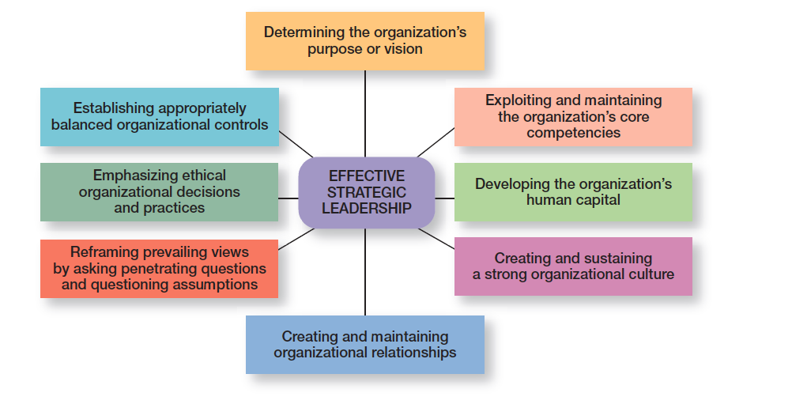
Exhibit 9-4 Effective Strategic Leadership
Exhibit 9-4 shows the eight key dimensions of strategic leadership.
Notes:
How can top managers provide effective strategic leadership? Eight key dimensions have been identified. (See Exhibit 9-4.) These dimensions include determining the organization’s purpose or vision, exploiting and maintaining the organization’s core competencies, developing the organization’s human capital, creating and sustaining a strong organizational culture, creating and maintaining organizational relationships, reframing prevailing views by asking penetrating questions and questioning assumptions, emphasizing ethical organizational decisions and practices, and establishing appropriately balanced organizational controls. Each dimension encompasses an important part of the strategic management process.
Sources: Based on J. P. Wallman, “Strategic Transactions and Managing the Future: A Druckerian Perspective,” Management Decision, vol. 48, no. 4, 2010, pp. 485–499; D. E. Zand, “Drucker’s Strategic Thinking Process: Three Key Techniques,” Strategy & Leadership, vol. 38, no. 3, 2010, pp. 23–28; and R. D. Ireland and M. A. Hitt, “Achieving and Maintaining Strategic Competitiveness in the 21st Century: The Role of Strategic Leadership,” Academy of Management Executive, February 1999, pp. 43–57.

Slide 29
The Need for Strategic Flexibility
Strategic flexibility: the ability to recognize major external changes, to quickly commit resources, and to recognize when a strategic decision was a mistake
Notes:
Strategic flexibility is the ability to recognize major external changes, to quickly commit resources, and to recognize when a strategic decision isn’t working. Given the highly uncertain environment that managers face today, strategic flexibility seems absolutely necessary!

Slide 30
Exhibit 9-5 Developing Strategic Flexibility
Technique
Encourage leadership unity by making sure everyone is on the same page.
Keep resources fluid and move them as circumstances warrant.
Have the right mindset to explore and understand issues and challenges.
Know what’s happening with strategies currently being used by monitoring and measuring results.
Encourage employees to be open about disclosing and sharing negative information.
Get new ideas and perspectives from outside the organization.
Have multiple alternatives when making strategic decisions.
Learn from mistakes.
Notes:
Sources: Based on Y. L. Doz and M. Kosonen, “Embedding Strategic Agility: A Leadership Agenda for Accelerating Business Model Renewal,” Long Range Planning, April 2010, pp. 370–382; E. Lewis, D. Romanaggi, and A. Chapple, “Successfully Managing Change During Uncertain Times,” Strategic HR Review, vol. 9, no. 2, 2010, pp. 12–18; and K. Shimizu and M. Hitt, “Strategic Flexibility: Organizational Preparedness to Reverse Ineffective Strategic Decisions,” Academy of Management Executive, November 2004, pp. 44–59.

Slide 31
Important Organizational Strategies for Today’s Environment
E-Business strategies
Customer service strategies
Innovation strategies
First mover: an organization that’s first to bring a product innovation to the market or to use a new process innovation
Notes:
Managers use e-business strategies to develop a sustainable competitive advantage. Cost leaders can use e-business to lower costs in a variety of ways. For instance, it might use online bidding and order processing to eliminate the need for sales calls and to decrease sales force expenses; it could use Web-based inventory control systems that reduce storage costs; or it might use online testing and evaluation of job applicants. A differentiator needs to offer products or services that customers perceive and value as unique. For instance, a business might use Internet-based knowledge systems to shorten customer response times, provide rapid online responses to service requests, or automate purchasing and payment systems so that customers have detailed status reports and purchasing histories. Finally, because the focuser targets a narrow market segment with customized products, it might provide chat rooms or discussion boards for customers to interact with others who have common interests, design niche Web sites that target-specific groups with specific interests, or use Web sites to perform standardized office functions such as payroll or budgeting.
Having an effective customer communication system is an important customer service strategy. Managers should know what’s going on with customers. They need to find out what customers liked and didn’t like about their purchase encounter—from their interactions with employees to their experience with the actual product or service. It’s also important to let customers know if something is going on with the company that might affect future purchase decisions. Finally, an organization’s culture is important to providing excellent customer service. This typically requires that employees be trained to provide exceptional customer service.
Innovation strategies aren’t necessarily focused on just the radical, breakthrough products. They can include applying existing technology to new uses. And organizations have successfully used both approaches. What types of innovation strategies do organizations need in today’s environment? Those strategies should reflect their innovation philosophy, which is shaped by two strategic decisions: innovation emphasis and innovation timing.
An organization that’s first to bring a product innovation to the market or to use a new process innovation is called a first mover. Being a first mover has certain strategic advantages and disadvantages as shown in Exhibit 9-6.

Slide 32
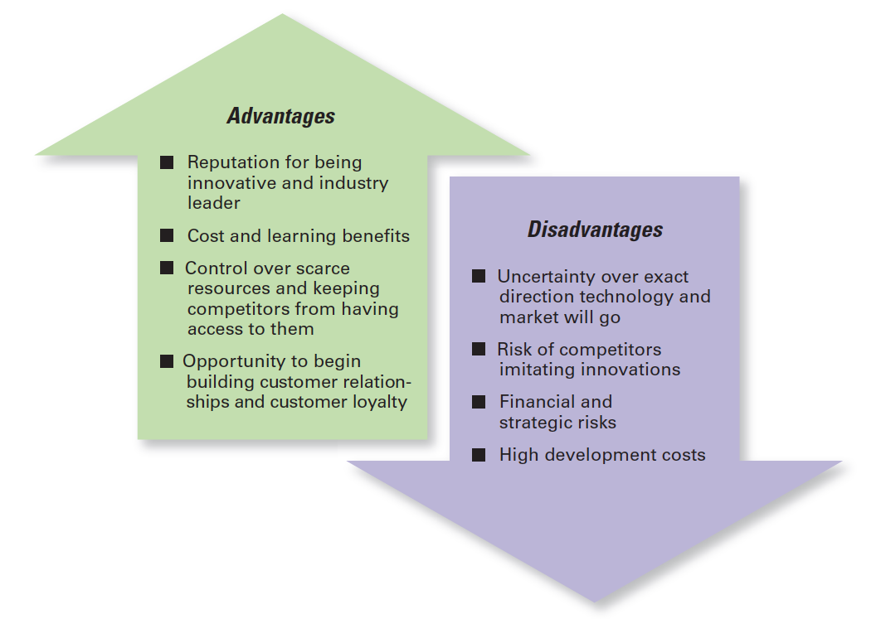
Exhibit 9-6 First Mover Advantages and Disadvantages
Exhibit 9-6 shows the strategic advantages and disadvantages of being a first mover.
Notes:
An organization that’s first to bring a product innovation to the market or to use a new process innovation is called a first mover. Being a first mover has certain strategic advantages and disadvantages as shown in Exhibit 9-6.

Slide 33
Review Learning Objective 9.1
Define strategic management and explain why it’s important.
Strategic management is what managers do to develop the organization's strategies
A business model is how a company is going to make money.
Notes:
Strategic management is what managers do to develop the organization’s strategies. Strategies are the plans for how the organization will do whatever it’s in business to do, how it will compete successfully, and how it will attract and satisfy its customers in order to achieve its goals. A business model is how a company is going to make money. Strategic management is important for three reasons. First, it makes a difference in how well organizations perform. Second, it’s important for helping managers cope with continually changing situations. Finally, strategic management helps coordinate and focus employee e orts on what’s important.

Slide 34
Review Learning Objective 9.2
Explain what managers do during the six steps of the strategic management process.
Identify the current mission, goals, and strategies
Do an external analysis
Do an internal analysis
Formulate strategies
Implement strategies
Evaluate strategies
Notes:
The six steps in the strategic management process encompass strategy planning, implementation, and evaluation. These steps include the following: (1) identify the current mission, goals, and strategies; (2) do an external analysis; (3) do an internal analysis (steps 2 and 3 collectively are known as SWOT analysis); (4) formulate strategies; (5) implement strategies; and (6) evaluate strategies. Strengths are any activities the organization does well or its unique resources. Weaknesses are activities the organization doesn’t do well or resources it needs. Opportunities are positive trends in the external environment. Threats are negative trends.

Slide 35
Review Learning Objective 9.3
Describe the three types of corporate strategies.
Growth strategies: concentration, vertical integration, horizontal integration, and diversification
Stability strategies
Renewal strategies: retrenchment and turnaround
BCG matrix
Notes:
A growth strategy is when an organization expands the number of markets served or products offered, either through current or new businesses. The types of growth strategies include concentration, vertical integration (backward and forward), horizontal integration, and diversification (related and unrelated). A stability strategy is when an organization makes no significant changes in what it’s doing. Both renewal strategies—retrenchment and turnaround—address organizational weaknesses leading to performance declines. The BCG matrix is a way to analyze a company’s portfolio of businesses by looking at a business’s market share and its industry’s anticipated growth rate. The four categories of the BCG matrix are cash cows, stars, question marks, and dogs.

Slide 36
Review Learning Objective 9.4
Describe competitive advantage and the competitive strategies organizations use to get it.
Competitive advantage
Porter’s five forces model
Porter’s three competitive strategies:
Cost leadership
Differentiation
Focus
Notes:
An organization’s competitive advantage is what sets it apart, its distinctive edge. A company’s competitive advantage becomes the basis for choosing an appropriate competitive strategy. Porter’s five forces model assesses the five competitive forces that dictate the rules of competition in an industry: threat of new entrants, threat of substitutes, bargaining power of buyers, bargaining power of suppliers, and current rivalry. Porter’s three competitive strategies are as follows: cost leadership (competing on the basis of having the lowest costs in the industry), differentiation (competing on the basis of having unique products that are widely valued by customers), and focus (competing in a narrow segment with either a cost advantage or a differentiation advantage).

Slide 37
Review Learning Objective 9.5
Discuss current strategic management issues.
Strategic leadership
Strategic flexibility
E-Business strategies
Notes:
Managers face three current strategic management issues: strategic leadership, strategic flexibility, and important types of strategies for today’s environment. Strategic leadership is the ability to anticipate, envision, maintain flexibility, think strategically, and work with others in the organization to initiate changes that will create a viable and valuable future for the organization and includes eight key dimensions. Strategic flexibility—that is, the ability to recognize major external environmental changes, to quickly commit resources, and to recognize when a strategic decision isn’t working—is important because managers often face highly uncertain environments. Managers can use e-business strategies to reduce costs, to differentiate their firm’s products and services, to target (focus on) specific customer groups, or to lower costs by standardizing certain office functions. Another important e-business strategy is the clicks-and-bricks strategy, which combines online and traditional, stand- alone locations. Strategies managers can use to become more customer oriented include giving customers what they want, communicating effectively with them, and having a culture that emphasizes customer service. Strategies managers can use to become more innovative include deciding their organization’s innovation emphasis (basic scientific research, product development, or process development) and its innovation timing ( first mover or follower).

Slide 38
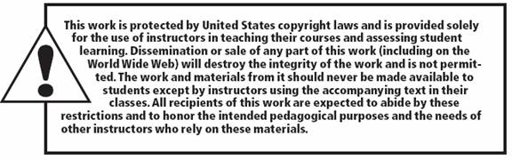
Copyright

